Slide 1

Slide 1
INTRODUCTION TO MATPLOTLIB
Padam Singh

Slide 2

Slide 11
AGENDA
Introduction
Why Matplotlib?
Installing Matplotlib
Getting Started
Creating Your First Plot
Line Plots, Scatter Plots, Bar Charts, Histograms, Pie Charts
Adding Labels and Titles
Subplots
Saving and Exporting Plots
Working with Data
Conclusion

Slide 3

Slide 6
MATPLOTLIB
Introduction
What is Matplotlib
Matplotlib is a powerful Python library for creating static, animated, and interactive visualizations in data analysis, scientific computing, and more.
Developed by John D. Hunter in 2002, Matplotlib has become a go-to tool for data visualization in the Python ecosystem.
Importance of Data Visualization
Data visualization is the graphical representation of data to understand patterns, trends, and insights.
It helps in making data more accessible and comprehensible, aiding in decision-making and storytelling.
Matplotlib plays a pivotal role in enabling data analysts and scientists to create compelling visualizations from their data.
1

Slide 4
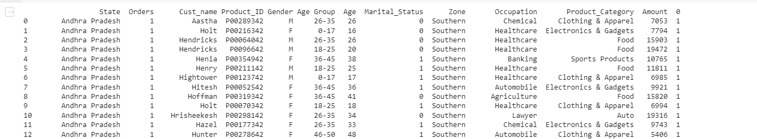
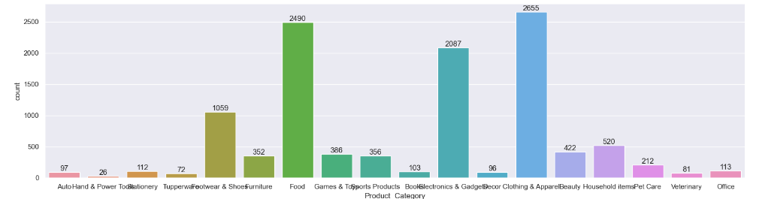
Slide 6
MATPLOTLIB
Why Matplotlib?
Benefits of Matplotlib
Versatile and widely used.
Highly customizable and integrates well.
Produces high-quality output.
2

Slide 5
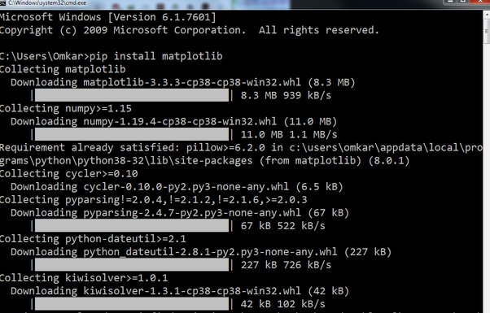
Slide 6
MATPLOTLIB
Installing Matplotlib
Installing Matplotlib Using pip
Open your command prompt or terminal.
Type: pip install matplotlib
Press Enter to initiate the installation.
Matplotlib and its dependencies will be downloaded and installed.
3

Slide 6
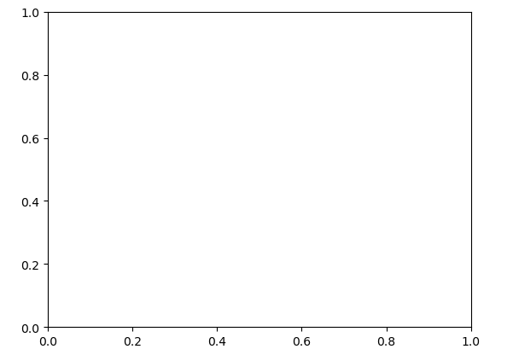
Slide 6
MATPLOTLIB
Getting Started
Importing Matplotlib
To use Matplotlib in your Python code, you need to import it.
Use the following import statement at the beginning of your script:
import matplotlib.pyplot as plt
Basic Structure of a Matplotlib Plot
Matplotlib uses a hierarchical structure for creating plots.
At the top level, you have a "Figure" that represents the entire image or layout.
Inside the figure, you have "Axes" that represent individual plots or charts.
Here's a basic structure to start a plot:
fig, ax = plt.subplots()
4

Slide 7
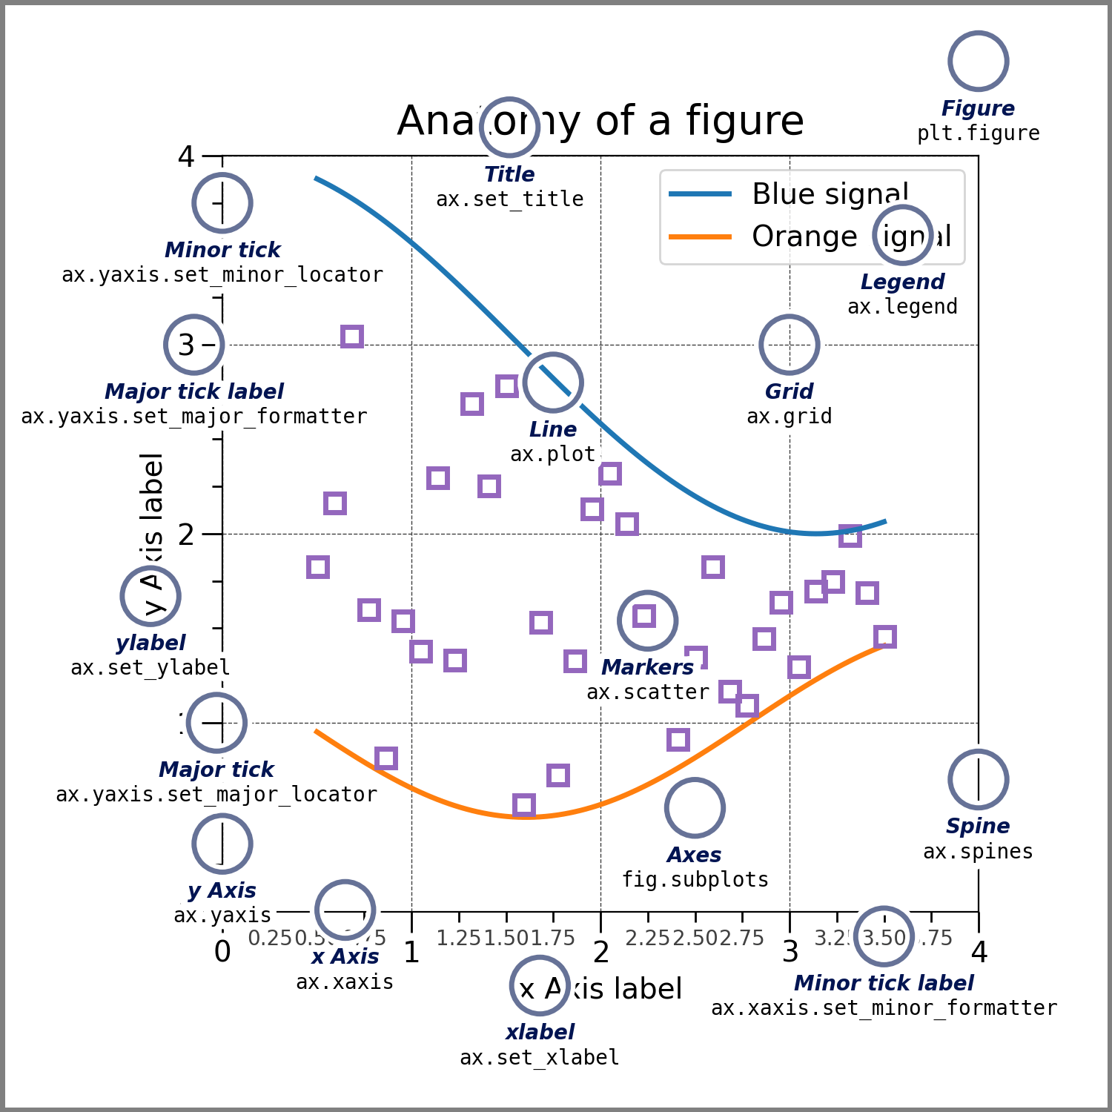
Slide 6

Slide 8
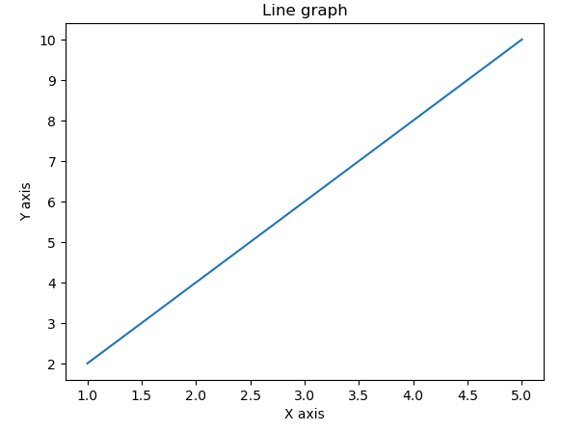
Slide 6
MATPLOTLIB
Creating Your First Plot
import matplotlib.pyplot as plt
x = [1, 2, 3, 4, 5]
y = [2, 4, 6, 8, 10]
# Plotting a graph
plt.plot(x, y)
# Assigning title to the graph
plt.title('Line graph')
# Labeling Y axis
plt.ylabel('Y axis')
# Labeling X axis
plt.xlabel('X axis')
# Display the result
plt.show()
5

Slide 9
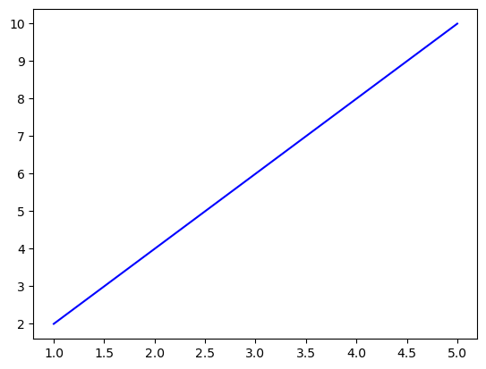
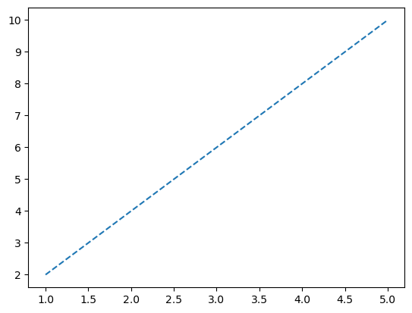
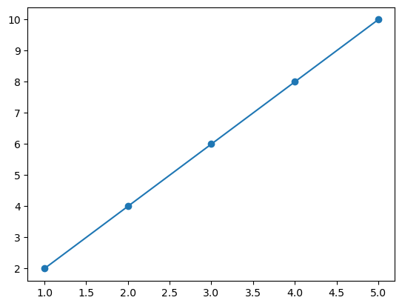
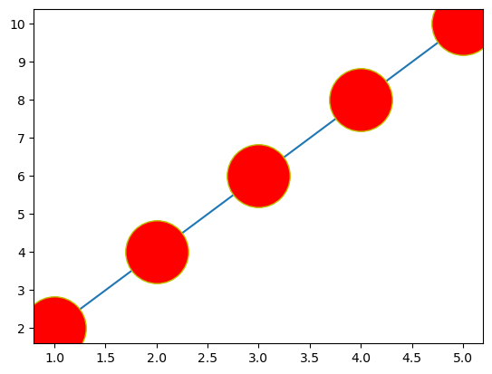
Slide 6
MATPLOTLIB
Line Plots
Creating Line Plots Using Matplotlib
Use plt.plot(x, y) to create a line plot.
x and y are arrays of data points.
6

Slide 10
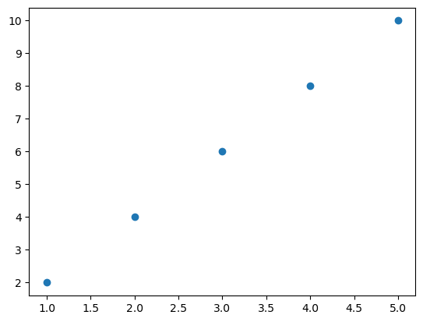
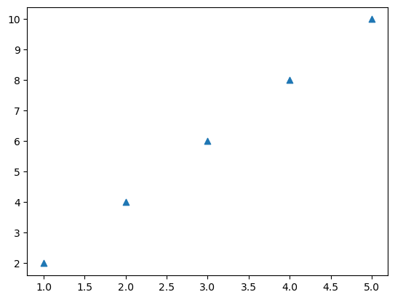
Slide 6
MATPLOTLIB
Scatter Plots
Creating Scatter Plots
Scatter plots display individual data points as dots on a graph, showing relationships between two variables.
Use plt.scatter(x, y) to create a scatter plot, where x and y are arrays of data points.
7

Slide 11
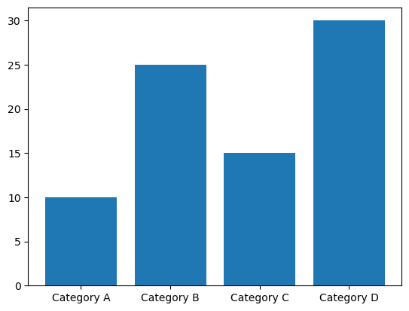
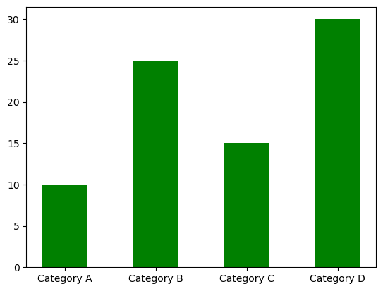
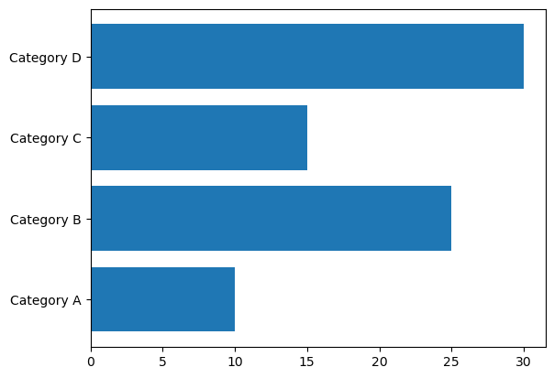
Slide 6
MATPLOTLIB
Bar Charts
Creating Bar Charts
Bar charts are used to represent data with rectangular bars, where the length or height of each bar is proportional to the data being represented.
Use plt.bar(x, y) to create a vertical bar chart and plt.barh(x, y) for horizontal bar charts.
8

Slide 12
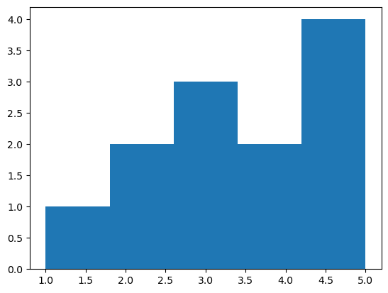
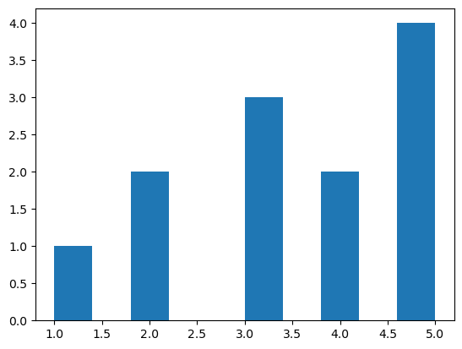
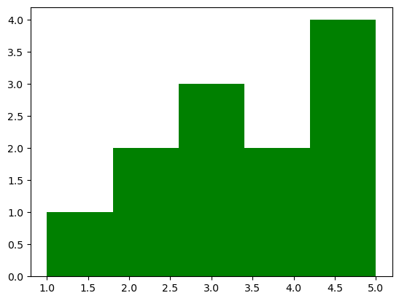
Slide 6
MATPLOTLIB
Histograms
Histograms are used to represent the distribution of a dataset by dividing it into bins and counting the number of data points in each bin.
Use plt.hist(data, bins) to create a histogram, where data is the dataset, and bins represent the number of bins or bin edges.
9

Slide 13
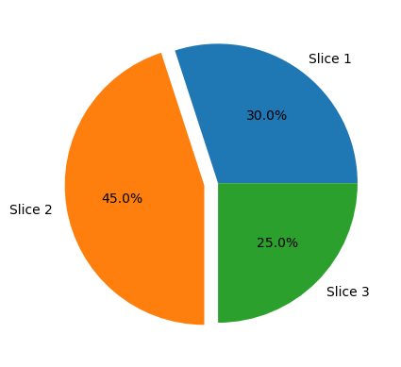
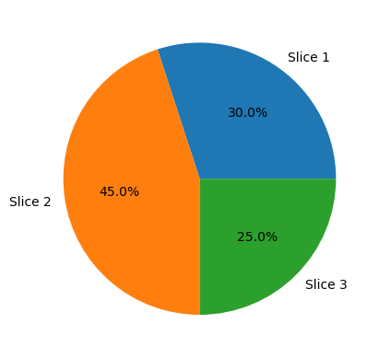
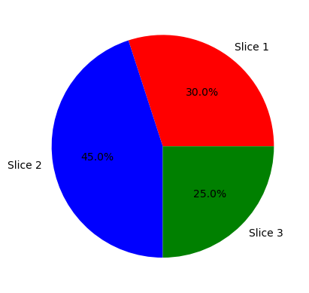
Slide 6
MATPLOTLIB
Pie Charts
Creating Pie Charts
Pie charts are used to represent data in a circular graph, where each "slice" of the pie represents a portion of the whole.
Use plt.pie(sizes, labels) to create a pie chart.
sizes are the sizes of each portion, and labels are the labels for each portion.
10

Slide 14
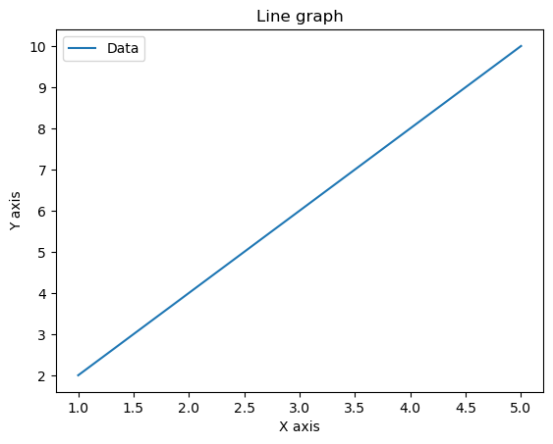
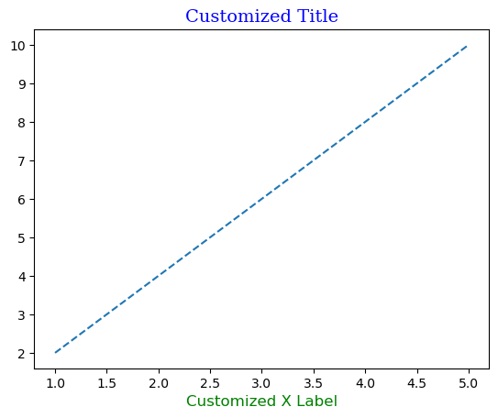
Slide 6
MATPLOTLIB
Adding Labels and Titles
Adding Titles, Axis Labels, and Legends
Titles, axis labels, and legends enhance the clarity and meaning of your plots.
Use functions like plt.title(), plt.xlabel(), plt.ylabel(), and plt.legend().
11

Slide 15
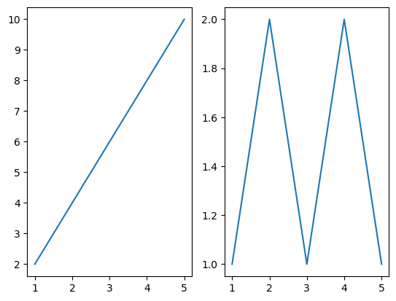
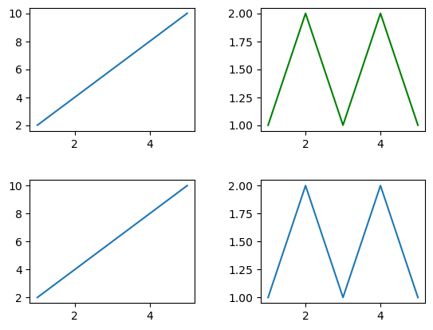
Slide 6
MATPLOTLIB
Subplots
Creating Multiple Plots in a Single Figure
Subplots allow you to display multiple plots in the same figure, ideal for comparing different datasets or aspects of your data.
Use plt.subplot() or plt.subplots() to create subplots within a figure.
12

Slide 16
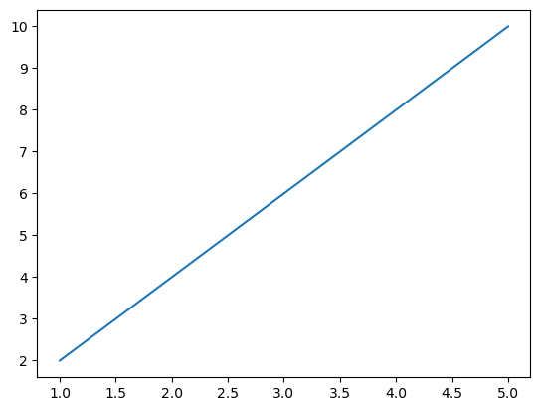
Slide 6
MATPLOTLIB
Saving and Exporting Plots
How to Save Your Matplotlib Plots as Image Files
Once you've created your Matplotlib plot, it's important to save it as an image for sharing, publication, or further use.
Matplotlib provides a simple method to save your plots in various formats, such as PNG, JPEG, PDF, and more.
Using savefig() for Saving Plots
To save a plot, use the savefig() function and specify the desired file format and file path.
Example: Saving the current plot as a PNG file.
import matplotlib.pyplot as plt
# Create a plot
plt.plot([1, 2, 3, 4, 5], [2, 4, 6, 8, 10])
# Save the plot as a PNG file
plt.savefig('my_plot.png', format='png')
Choosing File Formats
You can choose various file formats such as PNG, JPEG, PDF, SVG, and more by specifying the format parameter in savefig().
Select the format that best suits your needs, considering factors like image quality and compatibility.
13

Slide 17
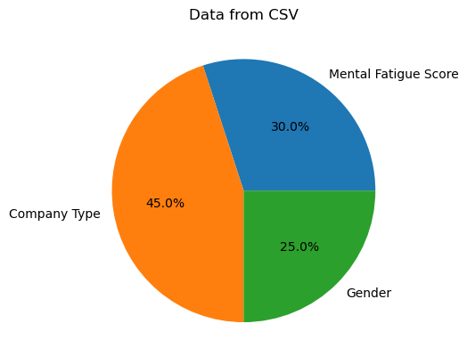
Slide 6
MATPLOTLIB
Working with Data
Loading Data from Various Sources
Matplotlib is often used with external data sources to create data visualizations.
You can load data from sources like CSV and Excel files using libraries like NumPy and Pandas.
14

Slide 18
Slide 6
MATPLOTLIB
Conclusion
Recap of Key Points
Matplotlib is a versatile Python library for creating a wide range of visualizations.
It's crucial for data scientists and analysts to effectively communicate insights through data visualization.
We've explored creating various types of plots, customizing them, and adding labels and titles for clarity.
Encourage Further Exploration and Usage of Matplotlib
Matplotlib offers endless possibilities for data visualization.
Continue to explore the library, experiment with different plot types, and customize your visualizations to meet your specific needs.
As you gain expertise, you'll be able to convey complex data in a more understandable and impactful way.
15

Slide 19
Slide 11
THANK YOU

